Slide 1
First Nation parcels & bounds:
Aboriginal title vis-a-vis Cowichan Tribes & Wolastoqey Nations
ANSLS AGM
October 8, 2026
Dr Brian Ballantyne
brian_ballantyne@hotmail.com
BoundaryIntelligence

Slide 2
Four themes
“A serious claim for [Aboriginal title] would indicate the boundaries of the land.”
  Kahentinetha v Societe Quebecois des Infrastructures (October 2025).
Territoriality: Indigenous peoples used parcels/bounds at both local (hunting groups) & regional levels.
“Let us face it, we are all here to stay.”
  Delgamuukw v BC (1997).
“Chillax, Bud.”
  Chiefs from four BC First Nations: “Land acknowledgements have never seized private property, cancelled a mortgage, repossessed a pickup truck, or altered a single title deed anywhere in Canada” (March 2026).

Slide 3
Seven-part structure
What is this seminar not about?
Peace & Friendship Treaties.
Test: Sufficiency/intensity, exclusivity, continuity.
Four cases (1997-2026): Aboriginal title if bounds defined.
Wolastqey Nations v Canada (2025).
Cowichan Tribes v Canada (2026).
Gaslighting & fear-mongering.

Slide 4
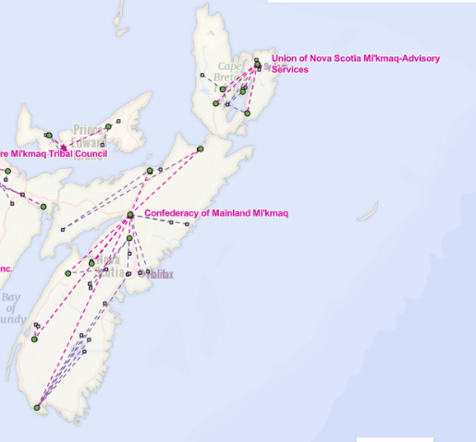
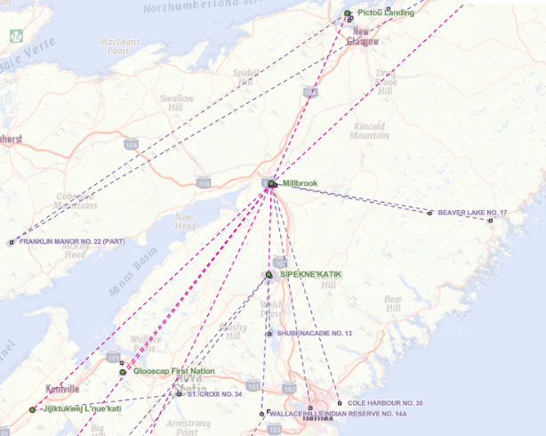
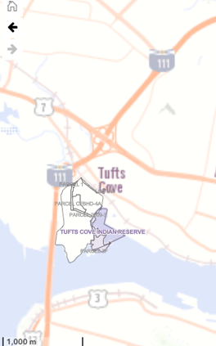
Mi’kmaw in Nova Scotia: 13 First Nations = 43 Reserves

Slide 5
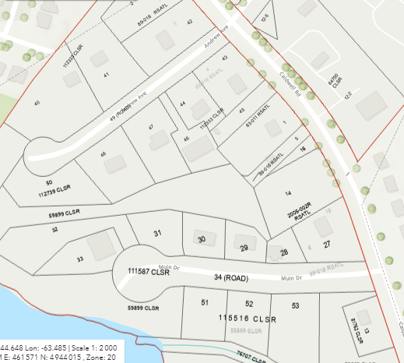

Slide 6
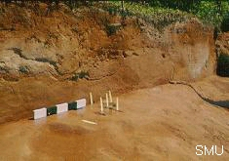
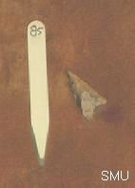
People were here 11,000+ years ago: Debert

Slide 7
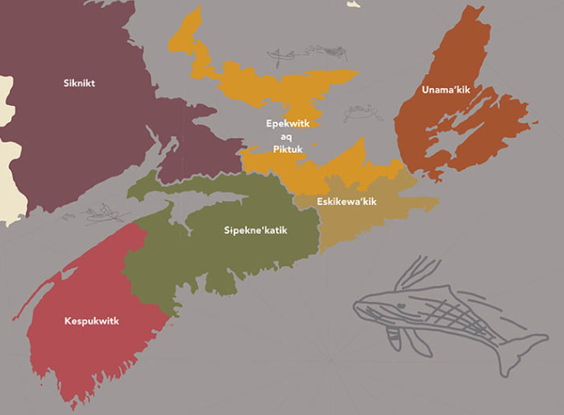
Mi’kma’ki

Slide 8
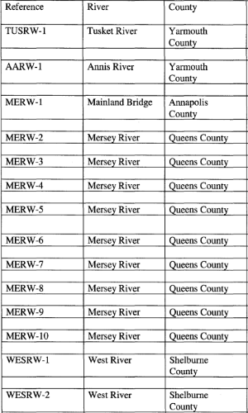
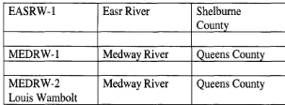
Pre-contact fish weirs were everywhere:
Sample of six rivers
Lewis. MA thesis. Memorial University. 2006.

Slide 9
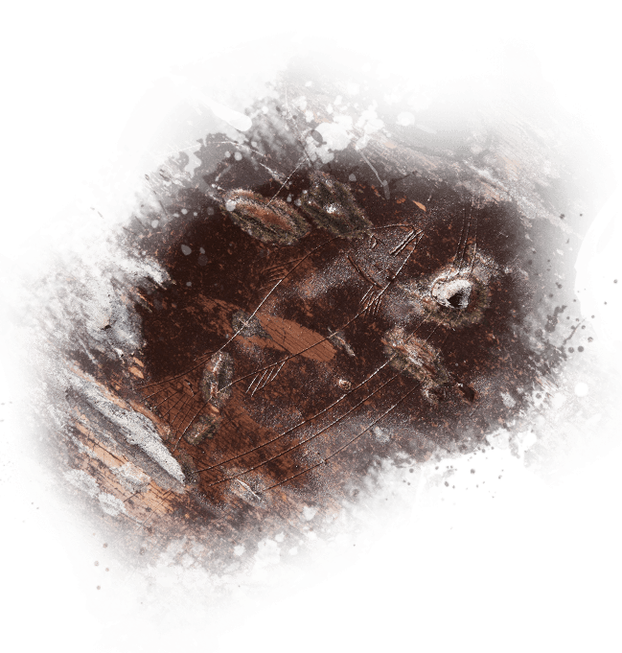
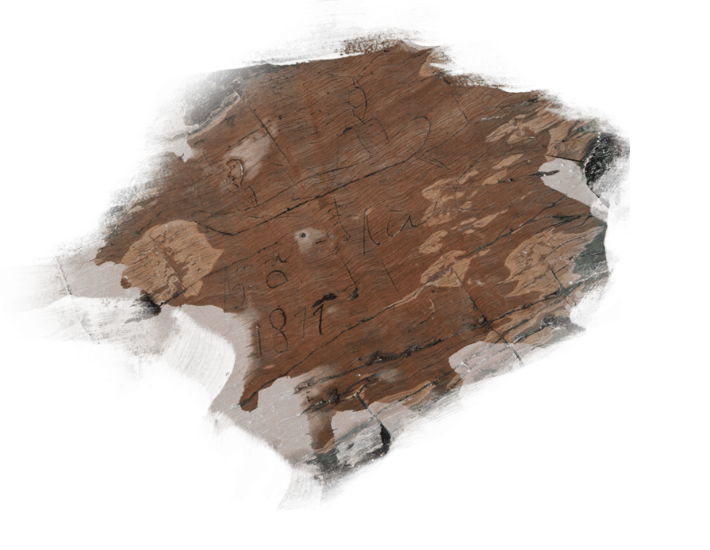
500+ petroglyphs: Kejikumik & George Lakes

Slide 10
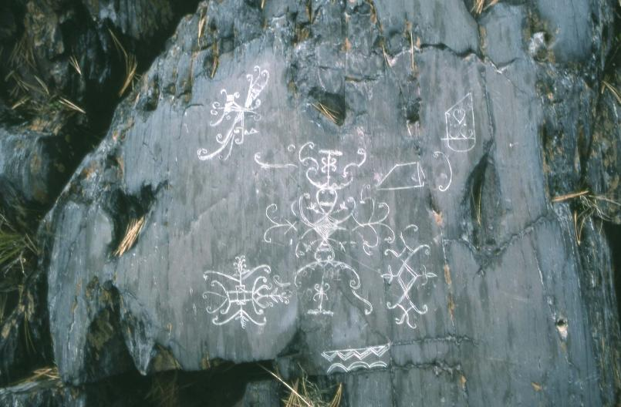
Wabanaki Confederacy:
Mi’kmaq, Maliseet, Passamaquoddy, Abenaki & Penobscot

Slide 11
Peace & Friendship Treaties
Purpose: To end war, encourage cooperation & negotiate settlement:
  1725/1726: First in Canada; designated an event of National Historic Significance in 2026 (300th anniversary).
  1749: Most Mi’kmaq refused to sign, angered by founding of Halifax.
  1752: Renewed the 1726 Treaty.
  1760: Restricted trading; only with British.
  1778/1779: In reaction to American revolution.

Slide 12
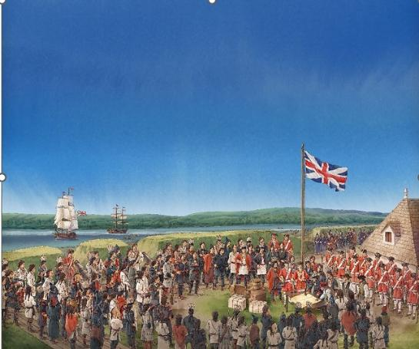
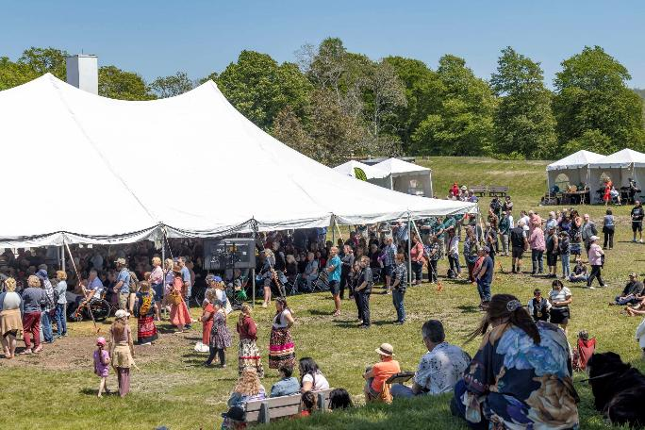

Slide 13
Intention & effect of Treaties
British (1725): “When we come to settle the bounds we shall neither build nor settle anywhere but within our own bounds so settled, without your consent.” Thus:
  Two parcels: Those with British settlement; those possessed by Mi’kmaw.
  Land possessed by Mi’kmaw bounded the land possessed by British.
Mikmaw: “We have never surrendered, ceded or sold the Aboriginal title to any of their lands.”
Canada: “The Treaties did not involve First Nations surrendering rights to the lands/resources they had traditionally used/occupied.”
SCC (1985): Treaty did not cede land or delineate boundaries.

Slide 14
Aboriginal title in Nova Scotia
R v Marshall (SCC – 2005):
  “Aboriginal societies were not strangers to … exclusive physical possession equivalent to common law notions of title.”
  “Mi’kmaq probably had Aboriginal title to lands around their communities.”
  British sovereignty: Mainland NS - 1713 & Cape Breton - 1763.
Assembly of Nova Scotia Mi’kmaq Chiefs (2010): Consultation ToR for “established or asserted Mi’kmaq Aboriginal or Treaty rights, including Crown land, water or a natural resource.”
Confederacy of Mainland Mi’kmaq (2015):
  Aboriginal title “to redress the loss of the use of land and resources within an entire territory.”
  “Land is not taken away from owners.” Rather, Mi’kmaq compensated with $ or Crown land.

Slide 15
Section 35 – 1982
Section 35 (1) of Constitution Act, 1982: “The existing aboriginal and treaty rights of the aboriginal peoples of Canada are hereby recognized and affirmed.”
Let’s focus on Aboriginal rights (not to discount Treaty rights):
    The Constitution recognizes/affirms existing rights.
    The Constitution does not establish/create new rights.

Slide 16
So, what is Aboriginal title?
Three rights:
  To exclusively occupy the land.
  To determine land uses.
  To enjoy the economic fruits of the land.
Three constraints:
  Title can only be transferred to the Crown.
  First Nation has title communally (but individuals can enjoy rights to parcels).
  Land uses must sustain future generations of Aboriginal peoples.
Province has no jurisdiction to extinguish Aboriginal title.

Slide 17
Three tests for Aboriginal title
Was land occupied at time of Crown sovereignty?
  1713 & 1763 (NS), 1759 (NB), 1763 (PQ & ON), 1846 (BC), 1870 (MB, SK, AB)
Was occupation exclusive?
  Did First Nation have the intention/capacity to control land?
  f(Aboriginal land law + evidence of occupation/intensity)
If relying on present occupation, has occupation been continuous since time of Crown sovereignty?

Slide 18
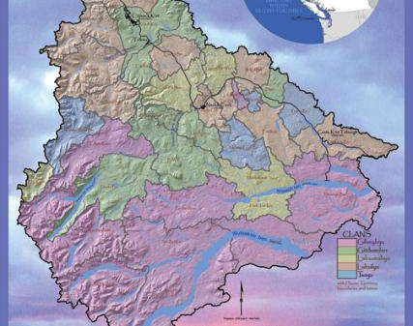
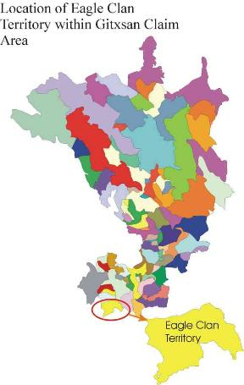
Delgamuukw v BC (SCC - 1997)
Area claimed = 58,000 km²
Consisting of 133 parcels = 71 Houses
All Wet’suwet’en Houses, who relied on:
adaawk: Sacred oral traditions about land
Most Gitksan Houses, who relied on:
kungax: Spiritual songs/dances about land

Slide 19
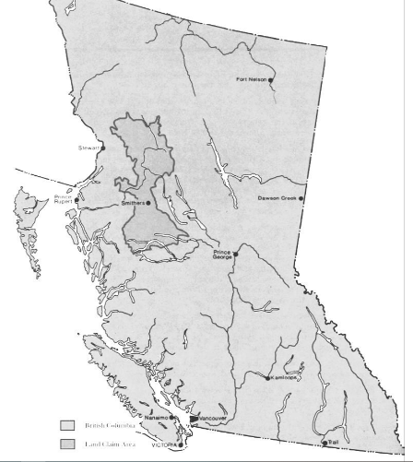
Floundered on boundaries
71 House claims were amalgamated into two communal claims, one by each First Nation.
“Territory claimed by each Nation is merely the sum of the individual claims of each House.”
Sadly, amalgamating was unfair to the Crown:
  “The collective claims were … not an issue at trial.”
  “The amalgamation of the … individual claims technically prevents a consideration of the merits.”

Slide 20
What does Delgamuukw tell us about bounds?
“An aboriginal society asserting the right to live on its ancestral lands must specify the area which has been continuously used and occupied. That is, the general boundaries of the occupied territory should be identified. I recognize, however, that when dealing with vast tracts of territory it may be impossible to identify geographical limits with scientific precision … Rather, the drawing of exact territorial limits can be settled by subsequent negotiations between the aboriginal claimants and the government.”

Slide 21
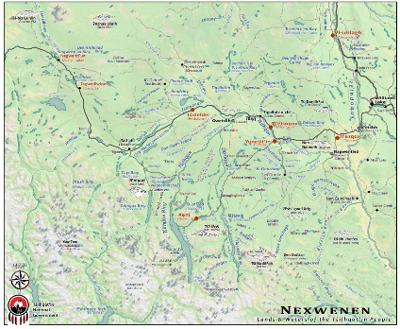
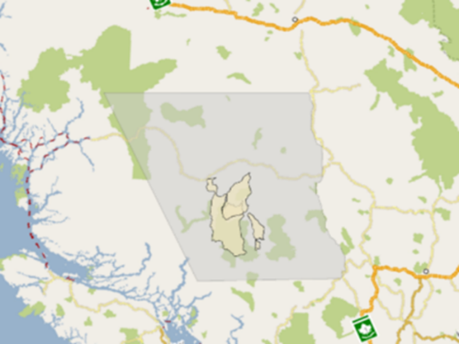
Tsilhqot’in v BC (SCC - 2014)
Traditional territory = 80,000 km²
Claim area = 4,000 km²
Culturally & spiritually significant areas within traditional territory

Slide 22
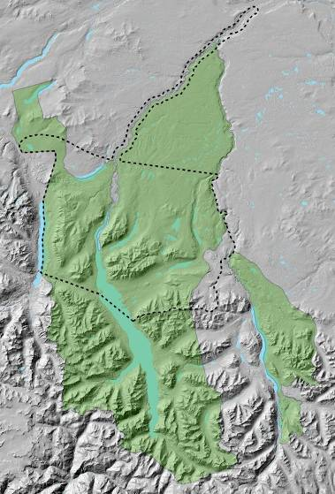
Claimed vs affirmed
Claimed area (green) = 420,000 ha (5% of traditional territory)
Affirmed area (dashed) = 190,000 ha
  Some sites in
  Some sites out

Slide 23
What does Tsilhqot’in tell us about bounds?
“The occupation of traditional territories by First Nations … was not based on a Torrens system, or, indeed, on any precise boundaries.”
“The limits of a traditional territory were typically ill-defined and fluid.”
“By examining a large number of individual sites, the trial judge was able to infer the boundaries within which the Tsilhqot’in regularly and exclusively occupied the land.”

Slide 24
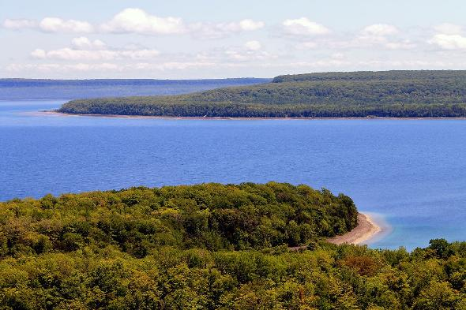
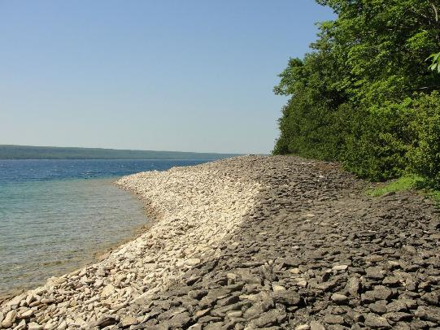
Chippewas of Nawash v Canada (ONCA - 2023)
Nochemowenaing (“healing place”)
South from Escarpment
Nochemowenaing
West along beach

Slide 25
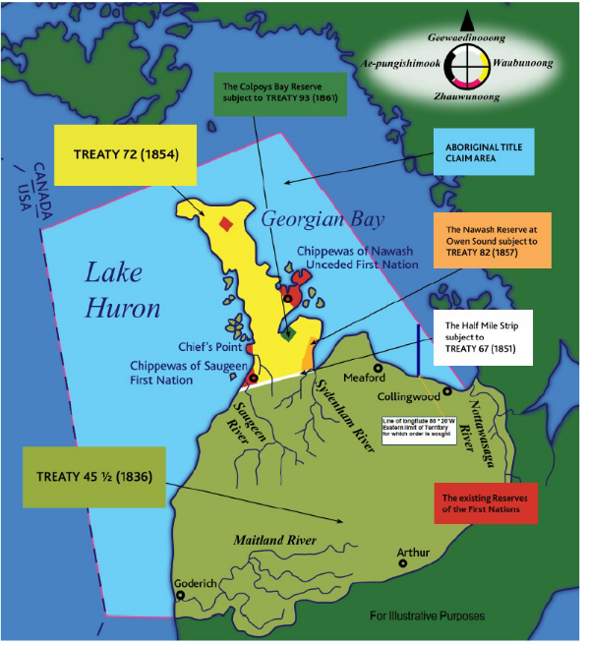
Aboriginal title claim to much of Lake Huron and Georgian Bay, bounded by:
Midline between Peninsula and Manitoulin Island
Midline of Georgian Bay
80-20-00 W line of longitude
International boundary
East-west line south of Goderich (in agreement with other FN)

Slide 26
At trial (2021): Floundered on boundaries
“The claim area is not connected to historical practices … Bounds surround an area that is much larger than any connection to the claimed land”:
  “The eastern boundary … is not based on historical traditional use.”
  “Chippewas have not proved that the southern boundary” existed in 1763.
  Traditional use of the area does not extend to the International boundary.
Nochemowenaing (“healing place”):
  “I expect more evidence about the area such as boundaries.”
What of Aboriginal title to parts of the claim area?
  “No alternative boundaries were put forward.” So, “the invitation to change the boundaries is left to guesswork.”

Slide 27
At appeal: Two fundamental questions on bounds
Was the relationship between navigable waters and Aboriginal title misperceived by trial judge (i.e. navigability extinguishes Aboriginal title)?
  Answer: Yes.
Should there be a process to assess an Aboriginal title claim to smaller parcels?
  Answer: Yes.
So, sent back to the trial judge to devise an efficient process to:
  Determine the spatial extent of Aboriginal title.
  Ascertain whether such parcels impede navigation.

Slide 28
Two principles
Aboriginal title to submerged lands might have no effect on, and be compatible with, the public right of navigation. Consistent with the common law:
  Many structures (e.g. piers) do not infringe navigation.
  Distinction between navigation (through water) and title (to bed).
It all hinges on the spatial extent of Aboriginal title:
  “To the claim area, or a discrete portion of the claim area.”
  “What is at stake is justice for the Aboriginal group and its descendants, and the reconciliation between the group and broader society.”

Slide 29
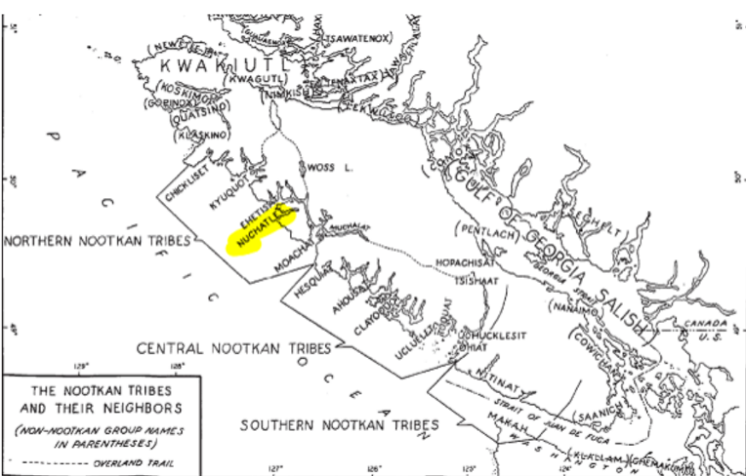
The Nuchatlaht v BC (BCCA - 2026)

Slide 30
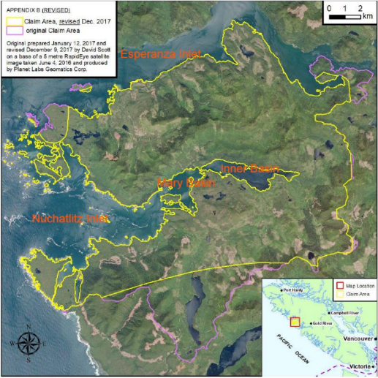
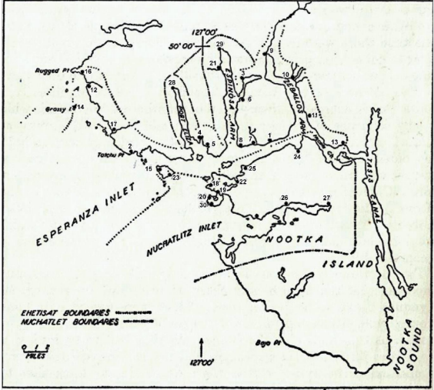
Area claimed = 201 km² (metes & bounds)

Slide 31
1st trial: Territoriality = f(parcels/bounds)
Local chiefs marked territories “by mutually recognized boundaries in the form of natural landmarks.”
They “had a concept of trespass.”
“The Nuchatlaht concept of property matched or exceeded that of the common law.”
“The Nuchatlaht has demonstrated an intention and capacity to control the land [that] I found it occupied in 1846.”

Slide 32
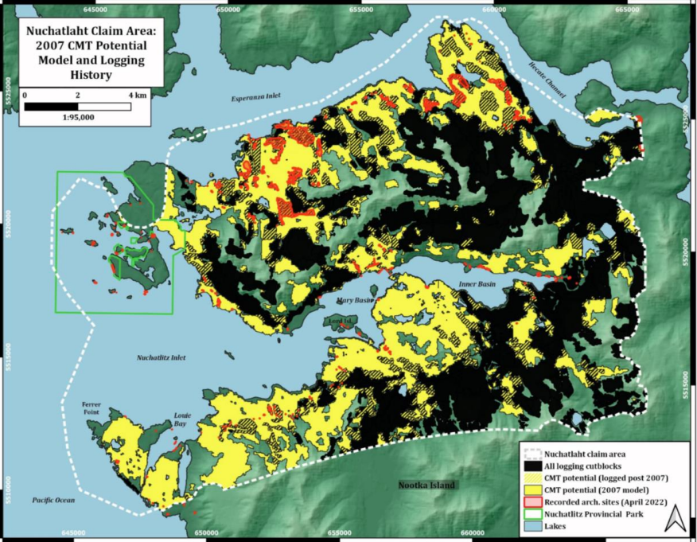

Slide 33
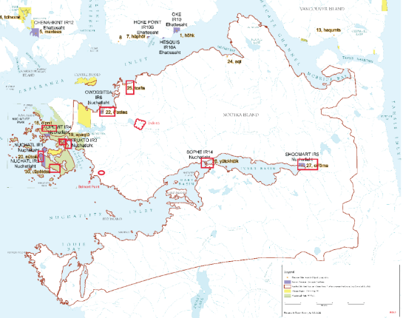
But, floundered on boundaries of coastal villages
FN relied on:
  Culturally-modified trees
  1953 map (1870-1906 time horizon)
No oral evidence (to shorten trial).
Bound not evidence of occupation.
“More detailed maps showing precise locations” of bounds needed.
But FN can claim areas of occupation (in red).

Slide 34
2nd trial: Larger claim areas, but only around IR
There must be “acts of occupation … demonstrating that the land in question belonged to, was controlled by, or was under the exclusive stewardship of the claimant group.”
Indian Reserves:
  Included most areas of sufficient occupation (1846).
  Bounds “may not have encompassed areas of sufficient occupation; … they were not set according to the current concept of Aboriginal title.”
BC conceded:
  “Aboriginal title near or adjacent to IR and accepted settlements.”
  Bounds at 100 m contour.
“There will no doubt be details to iron out in establishing the precise boundaries. I hope that by this stage those can be agreed to.”

Slide 35
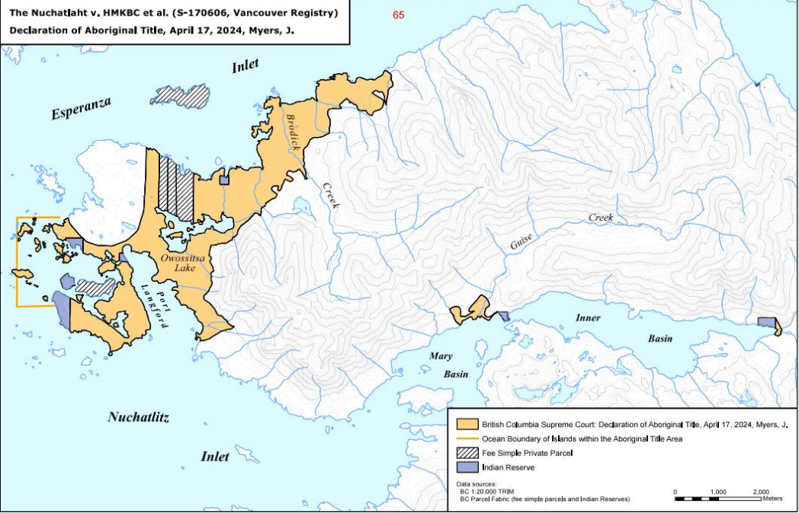

Slide 36
Appeal: “Bound drawn without reference to principles”
Task: To “determine appropriate bounds of Aboriginal title.”
Labrador Boundary (1927) rejected as rationale for 100 m contour:
  Case merely interpreted legislation (e.g. Royal Proclamation 1763).
  Watershed merely a presumption (not a principle) in international law.
“Inappropriately narrow site-specific approach”:
  Ignored evidence of use of the interior area (“remote inland” but only 7 km wide).
  Relied on evidence linked to village sites or IR.
  Adopted an arbitrary boundary (100 m), which reflected neither evidence of culturally-modified trees nor “the regular use or geography of the land.”
FN “have established … title to the whole area they have claimed.”

Slide 37
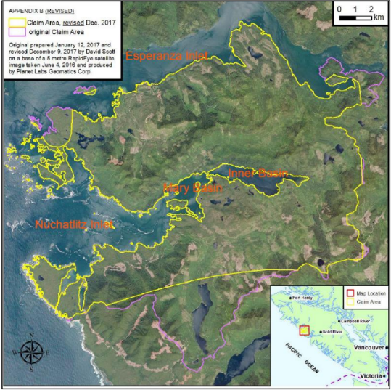
Yellow inside purple (no other claims or 3rd parties)

Slide 38
Rising Tide (Haida Title Lands) Agreement: 2024
Haida and BC recognize/affirm that Haida Nation has Aboriginal title to Haida Gwaii.
Sets out a process for reconciling jurisdiction/laws on Haida Gwaii.
Haida Gwaii means the terrestrial areas and submerged lands.
Nothing in Agreement derogates from:
  Fee Simple Interests. Such parcels will only be acquired by Haida Nation from willing sellers, by gift/will, or through escheat (no will/heir).
  Local Governments and Village Councils.
  The delivery of public services on Haida Gwaii.

Slide 39
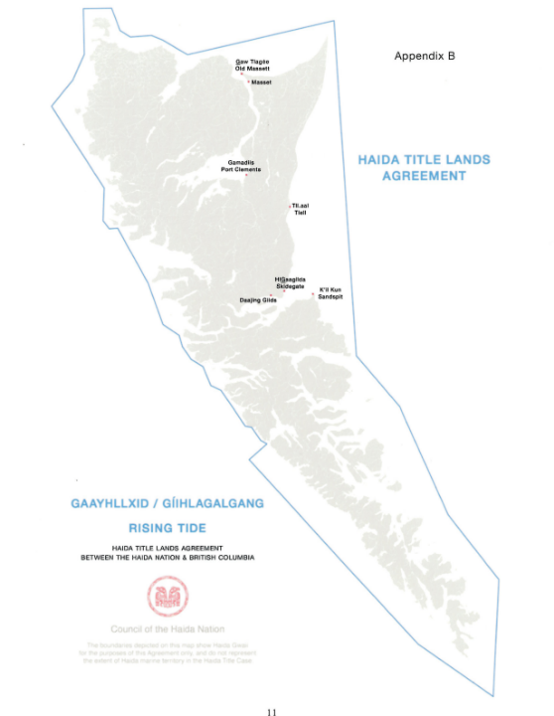
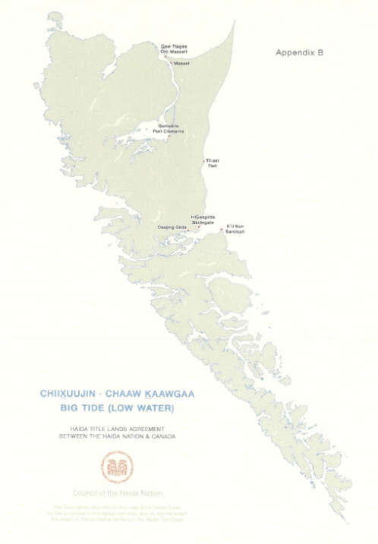

Slide 40
JD Irving v Wolastoqey Nations (NBCA - 2025)
November 2024: Procedural hearing (not yet a trial on the facts).
Six First Nations claim Aboriginal title to western part of NB:
  252,000 fee simple parcels: Seven Industrial Defendants (ID) & “Strangers to the Claim.”
  30,446 parcels of ungranted Crown lands.
  Claim is not “frivolous, vexatious or abusive.”
First Nation:
  Can claim against Crown (Canada & NB) as a constitutional challenge.
  Cannot claim against private parties (ID or Strangers).

Slide 41
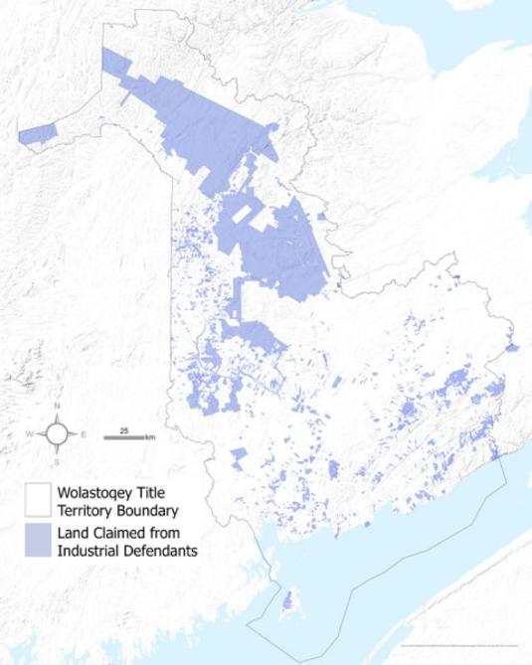
West part of New Brunswick
10,000 km² claimed from ID (blue)
Traditional territory = 50,000 km²
Upland
Watercourses/ocean

Slide 42
Appeal: Declaration vs finding
“It is plain & obvious that this claim has no chance of success at trial”
First Nation cannot claim against the Crown for a declaration of Aboriginal title over fee simple lands, because:
  ID would not participate in the process.
  Vesting of rights in First Nation are irreconcilable with the rights of ID.
  No allegation of any wrong committed by the ID or Strangers (“innocents”).
First Nation can claim against Crown for a:
  Declaration of Aboriginal title (relief = land) over Crown lands (30,000 parcels).
  Finding of Aboriginal title (damages = $) over fee simple lands held by ID and Strangers (252,000 parcels).

Slide 43
Post-Wolastoqey commentary
Rationale for NBCA findings is “novel.”
Negotiation will follow any declaration, resulting in Crown:
  First, offering compensation.
  Then, buying lands from willing sellers at market value.
  Then, expropriating with compensation.
Double standard:
  When Aboriginal title affects fee simple land, First Nation not entitled to land.
  When Crown granted lands in fee simple, First Nation was never consulted.
Fee simple prioritized over “constitutionally protected Aboriginal title”:
  “Reconciliation will never be achieved if the rights on non-Indigenous Canadians are always privileged” over the rights of Indigenous Canadians.

Slide 44
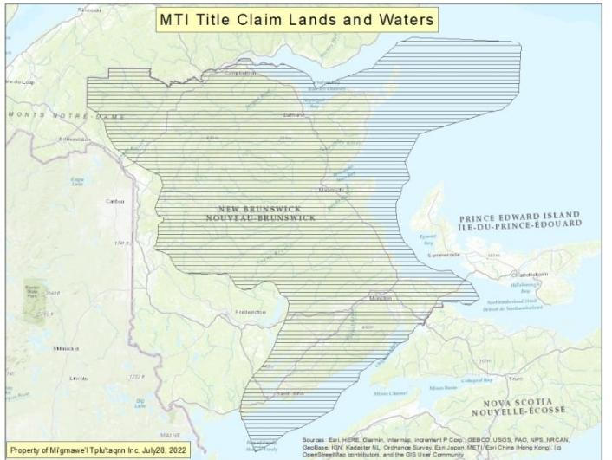
Mi'gmawe'l Tplu'taqnn Inc (MTI):
Eight Mi'kmaw communities (2023)

Slide 45
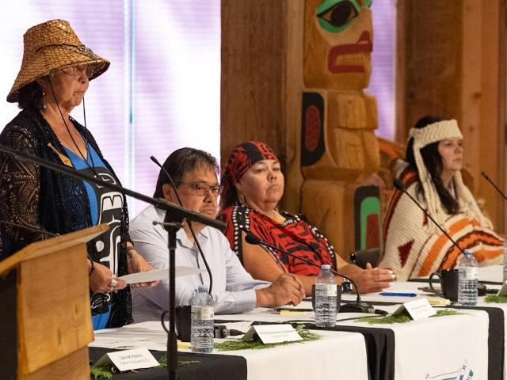
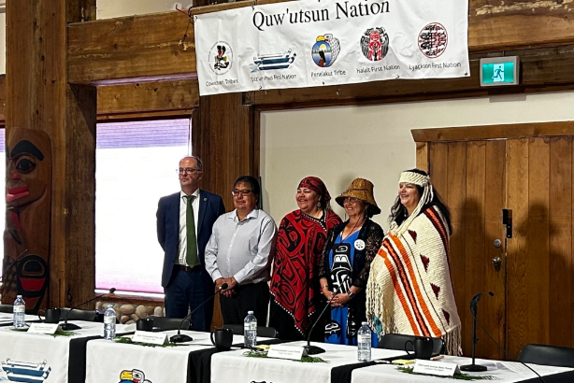
Cowichan Tribes v Canada (BCSC -2025)

Slide 46
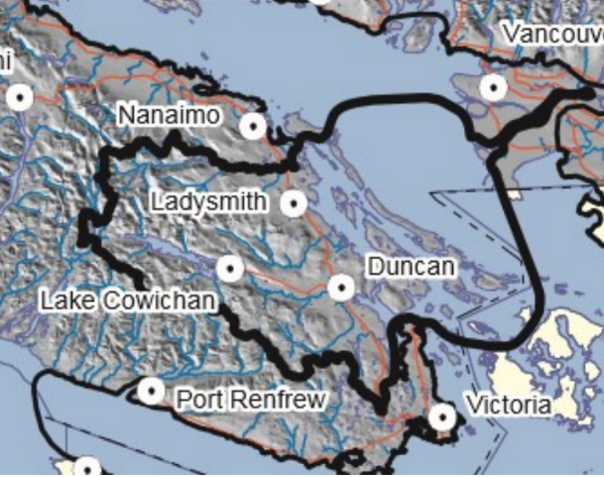
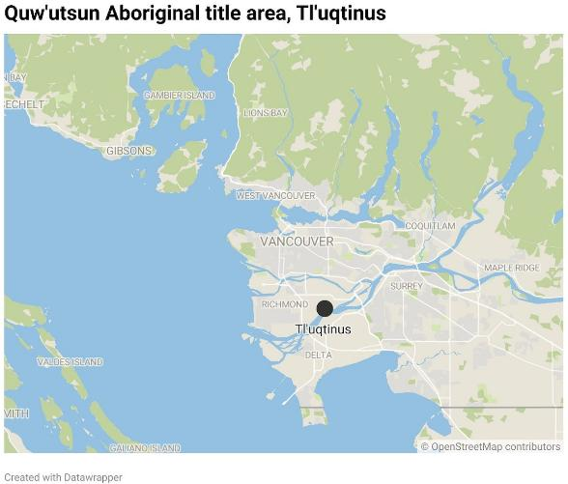
Hul’qumi’num Treaty Group

Slide 47
Trial
513 trial days (over six years).
86 lawyers.
2,858 exhibits.
863 pages (3,728 paragraphs).
Oral history from:
  Cowichan Tribes.
  Stz’uminus First Nation
  Penelakut First Nation.
  Halalat First Nation.
  Lyakson First Nation.
Expert evidence in archaeology, socio-cultural anthropology, history, ethnohistory, ethnogeography, ethnobotany, genealogy, historical geography, cartography, and transport economics.

Slide 48
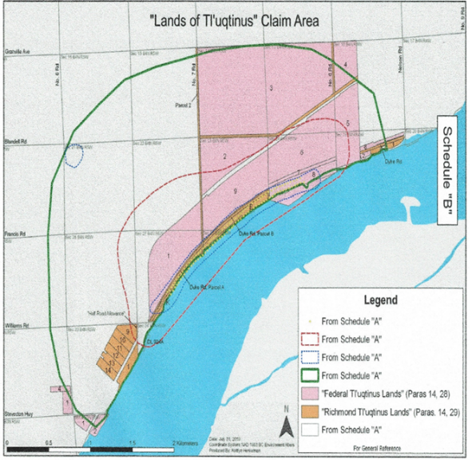
Claim area = 1,846 acres (houses & foraging)

Slide 49
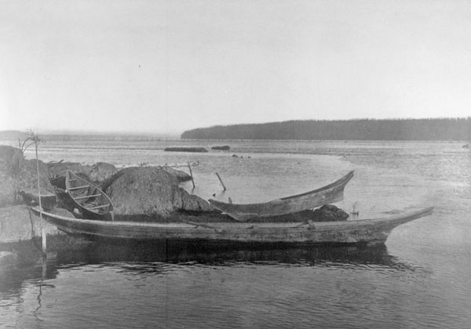
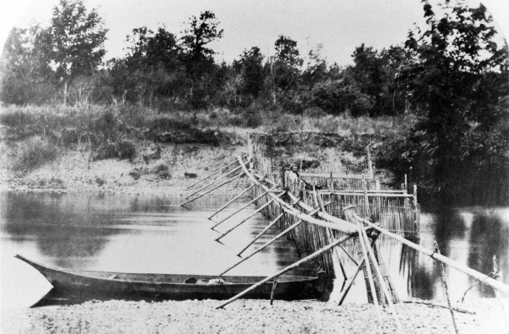
Governor Douglas (1861): First Nations had “distinct idea of property in land” with “several exclusive possessory rights in certain districts.”

Slide 50
Tl’uqtinus (“long chest” = sloping beach)
Village “inexorably tied to the Cowichan way of life”
Every summer, Cowichan travelled en masse (2,000+) from Vancouver Isle/Gulf Islands to south arm of Fraser River.
Posts and beams of houses were permanent fixtures at Fraser River:
  Houses were 60 ft x 60 ft.
  Planks were transported biannually, which served as walls/roofs of houses.
“The existence of permanent structures indicates a consistent presence on the land and an intention to hold possession at all times.”
Village size observed in 1824 and 1859.

Slide 51
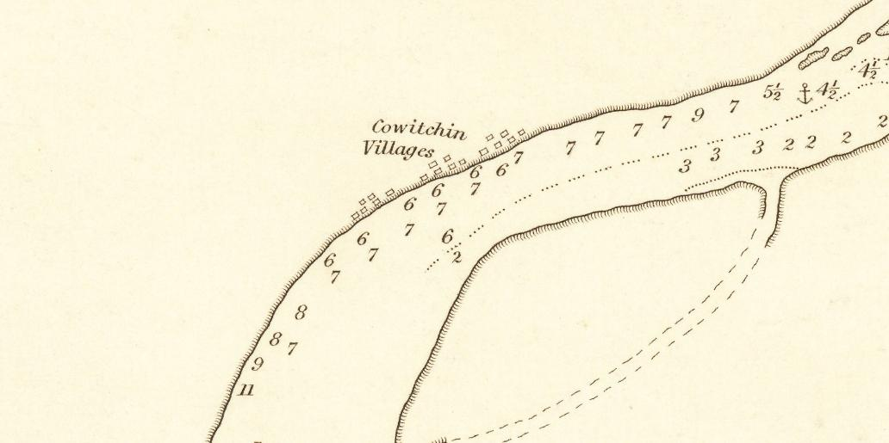

1827

Slide 52
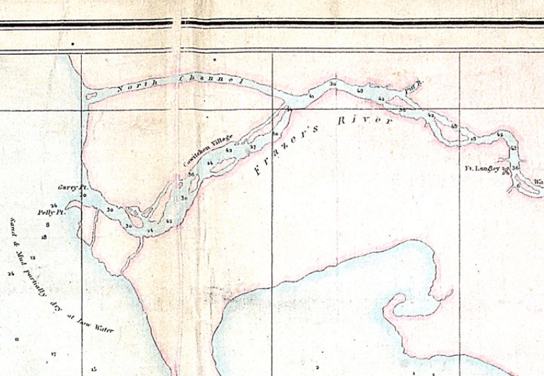

1854

Slide 53
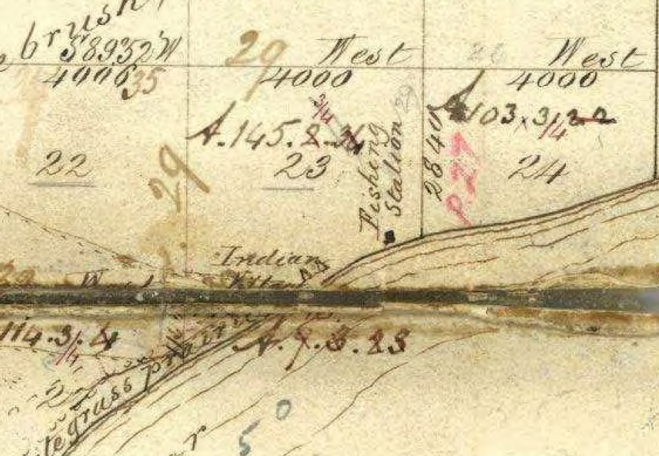


1859
Trutch surveyed
S23, Block 4, R5W
- “Indian Village”
- “Fishing Station”

Slide 54
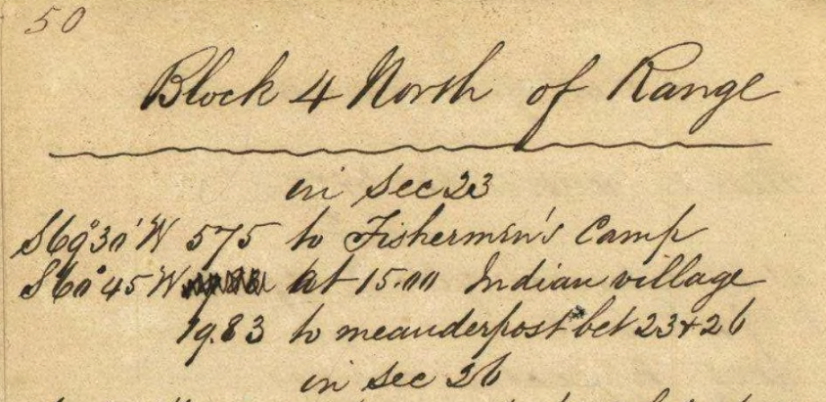
River traverse:
“Indian village”

Slide 55
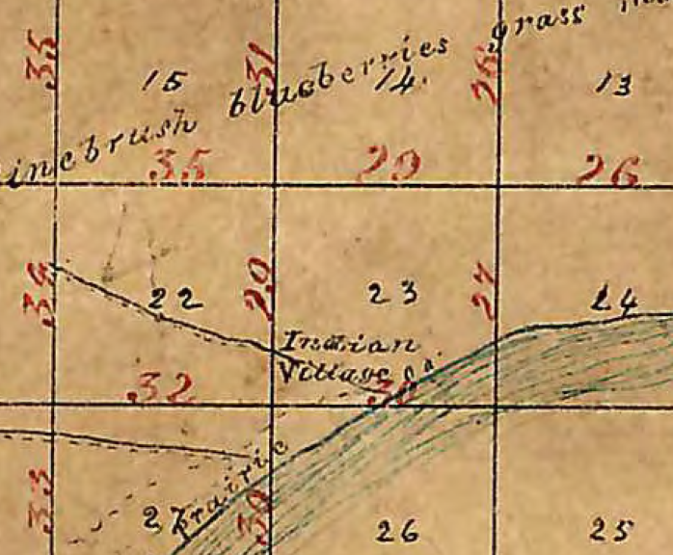
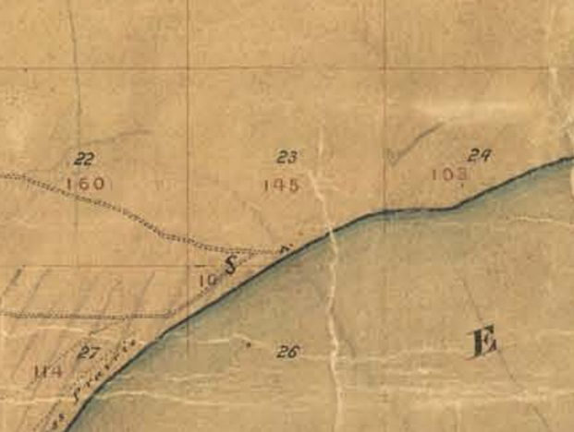

Plans drafted “from the field notes of JW Trutch”

Slide 56
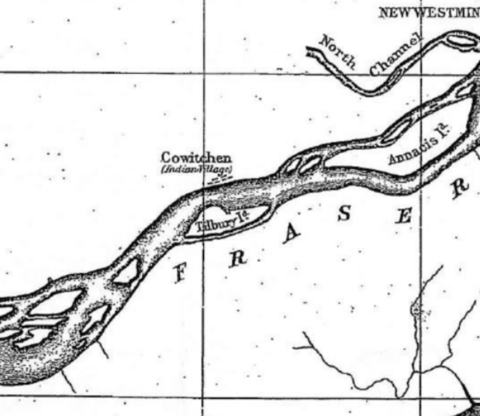

1869

Slide 57
History
Annance & Work (late-1824) camped at Cowichan Village:
  “Terrible large village … Deserted village nearly a mile long.” 108 longhouses = 1,000+ men.
Governor Douglas (1853):
  Told Quw’utsun that he would treat them “with justice and humanity;” honour of the Crown.
Governor Douglas (1859):
  Exempted Indian settlements from Crown lands disposition; Reserves were to be created.
Surveyor Trutch (1859) surveyed Lulu Island:
  Noted an “Indian Village” and “fisherman’s camp” in S23, Block 4N, R5W (FB 11-59).
Crown grants of claim area (1871-1914) “with no regard for the Cowichan’s interest”:
  Pre-Confederation (1871): Made without statutory authority.
  Post-Confederation (1871): Made without constitutional authority (BC Terms of Union, Art 13).
Commissioner of Lands Moody (1859-63) took much land “dishonourably” in 1871:
  Moody “acted in his own self-interest, contrary to Douglas’ directions and colonial policy.”

Slide 58
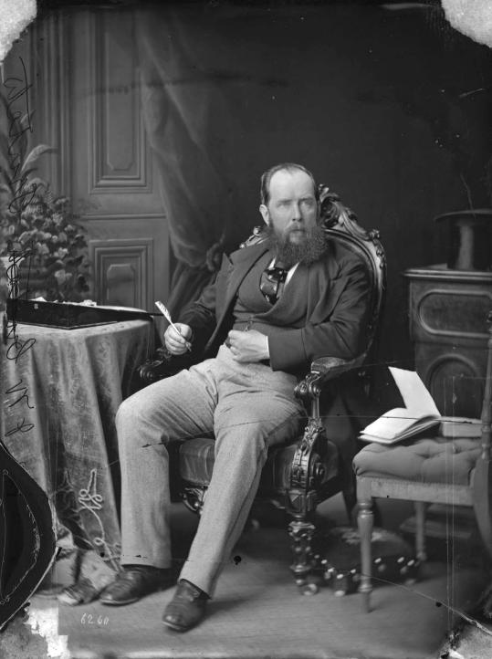
Joseph Trutch
- Surveyor (1859)
- Commissioner of Lands & Works
- Lieutenant-Governor
Indigenous people: “The ugliest & Laziest creatures I ever saw, & we should as soon think of being afraid of our dogs as of them”

Slide 59
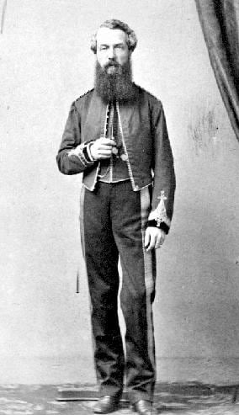
Richard Moody
- Commissioner of Lands & Works
- Lieutenant-Governor
- Acquired 3,000 acres of land as a speculator.
- Fraud: “Imperfect method in conveying public lands.”

Slide 60
Cowichan “maintained a substantial connection to their land, which they have not abandoned today.”
1856: Governor Douglas noted that 1,000 Cowichan men were at Fraser River.
1867: Lomas noted that Cowichan villages on Vancouver Isle were almost empty.
1875: Settlers complained about Cowichan, who “admonished them for taking Cowichan land.”
1878: Indian Reserve Commissioner Sproat lamented that “an old fishing place on Frazer River frequented by the Cowichan as a winter fishing place has been sold some time ago over their heads.”
1881: Lomas observed that most Cowichan were fishing at the Fraser River.
1901: Tate noted that Cowichan villages on Vancouver Isle were nearly deserted.
1955: Mrs. James travelled to the village/site to fish and to harvest berries.

Slide 61


Slide 62
Four findings
Cowichan “do not rely on present occupation as proof of 1846 occupation.”
There has been unjustified infringement of Aboriginal title by:
  Crown granting fee simple interests.
  Crown (British Columbia) vesting City of Richmond with fee simple interests (through tax sales) and soil/freehold of highways.
  Some activities of Canada and VFPA.
Cowichan ability to fish Fraser River south arm is severely impeded.
“Province has no jurisdiction to extinguish Aboriginal title. The Crown grants of fee simple interest did not displace or extinguish the Cowichan’s Aboriginal title … I can think of no more harmful conduct than selling Aboriginal title to third parties without first consulting with the Indigenous people who live there, and without obtaining their consent.”

Slide 63

“Cowichan Title Lands” = 750 acres

Slide 64



Slide 65
Eroded part of village = Submerged lands
Since 1859, 20-45 m of erosion to north (right) bank of river.
Court relied on Chippewas of Nawash (2023):
  Tsilhqot’in test (sufficient/exclusive/continuous) can be adapted to bed.
  Not every use of submerged lands interferes with navigation (e.g. piers).
  Aboriginal title to bed might be compatible with public right of navigation.
BC conceded that Haida Aboriginal title includes beds (2024).

Slide 66

Right bank in 1859
Right bank now
Submerged land =
Erosion
Fluvial highway?

Slide 67
Six declarations: Private property not cancelled
Cowichan have Aboriginal title to Cowichan title lands.
Crown grants of fee simple and Crown vesting of highway lands unjustifiably infringed Aboriginal title.
Canada and Richmond titles/interests are defective and invalid (except Airport Fuel lands) – suspended for 18 months.
Canada owes a duty to negotiate to reconcile Airport Fuel lands fee simple with Aboriginal title.
BC owes a duty to negotiate to reconcile third party/Richmond fee simple with Aboriginal title.
Cowichan have Aboriginal right to fish Fraser River south arm for food.

Slide 68


Slide 69
Fee simple vs Aboriginal title: Both restricted
“The question is not whether Aboriginal title can exist over fee simple lands, but whether fee simple interests can exist on Aboriginal lands. In my view … the answer to that question is yes.”
Three restrictions on Aboriginal title: Transferred only to Crown, held communally, enjoyed by future generations.
Many restrictions on fee simple title:
  Public policy (e.g. rule against perpetuities; restrictive covenants).
  Statutory restraints (e.g. matrimonial property).
  Law of nuisance.
  Environmental protection/land use planning/zoning.
  Expropriation.
  Use of airspace/minerals.

Slide 70


Gaslighting: Mayor Brodie, Premier Eby, and …

Slide 71





Slide 72



Slide 73
#1: Titles/interests that the Cowichan “chose to attack.”
“None of the affected private landowners were given formal notice of the legal proceedings.”
Actually:
  In 2017, Canada asked court to order that Cowichan or BC notify 200 (*really 45*) affected private landowners.
  Court declined, for three reasons:
    Cowichan “are NOT seeking a declaration of invalidity or defectiveness” over such parcels, nor do Cowichan claim possession of such parcels.
    Adding up to 200 new parties would “put a halt to these proceedings.”
    “It is open to the defendants to provide notice … My decision does not prevent any of the defendants from providing informal notice to private landowners.”

Slide 74
#2: Titles/interests that the Cowichan “chose to attack.”
Lands the Cowichan “had abandoned … 150 years in the past.”
Actually:
  1858: Fraser Valley gold rush (25,000 miners) hindered salmon spawning.
  1859: Crown surveyed the village site.
  1871-1914: Crown granted the village site.
  Nevertheless, Cowichan continued to fish in south arm of Fraser River.
  Cowichan complained/petitioned Crown about loss of village.
  1906: Delegation to King Edward VII to grieve “encroachment onto their traditional land,” included Cowichan Chief Isipaymilt.

Slide 75



Slide 76
#3: Titles/interests that the Cowichan “chose to attack.”
Decision “introduces enormous uncertainty into the security of any title in British Columbia.”
Actually:
  Cowichan grievance is with BC Crown.
  “Cowichan have taken an approach in this litigation that fosters reconciliation by involving only the proper parties [Crown and City].”
  Haida Agreement is an exemplar:
    First Nation - Crown agreement, hived off from litigation.
    Fee simple parcels not affected.

Slide 77
It gets better … City of Richmond v2.0 (2025)
“They had a shovel-ready project that was worth about $100 million. It represented a lot of jobs and more sort of tech medical industry-type jobs, so good jobs. [National Bank] basically said financing’s off for this project. We’re not ready to support a new project in that area in the Cowichan Tribes’ land dispute area.”
    Councilor Alexa Loo, City of Richmond. October 31, 2025.
The Cowichan Tribes ruling “is not a factor that is taken into account in our financing decisions, and no guidelines have been issued by the bank in this regard.”
    National Bank. November 4, 2025.

Slide 78

Versante Hotel

Slide 79
Cowichan decision is “scaring away investors”
December 2025: An offer to purchase Versante Hotel was withdrawn in August 2025 owing to “uncertainty around land title ownership and potential precedent risk.”
Actually:
  Hotel is not within Cowichan Title Lands; it is 8.4 km north (near airport).
  Hotel owed $113M to creditors; it was a court-ordered sale.
  Hotel was bought for $52M in October 2025.

Slide 80
BC: Premier Eby & Attorney General Sharma
August 11, 2025: “This ruling could have significant unintended consequences for fee simple private property rights in BC.”
September 7, 2025: “These are profound issues that are hard to consider in the absence of the real people … the homeowners, the business owners, who will be affected by this decision.”
November 4, 2025: “We believe the judge made some very serious errors in relation to private property owners in Richmond … they weren’t even notified that this proceeding was happening.”
November 28, 2025: BC promised $154M in loan guarantees to landowners, despite “the banks informing BC that they have not changed lending policies.”

Slide 81
Conservative Party of British Columbia
“This ruling is wrong – and it MUST be overturned ASAP.”
    e-mail to supporters (August 2025).
”Indigenous rights and private property rights cannot co-exist.”
    John Rustad, Leader of the Opposition (September 25, 2025).
It is a “dangerous precedent” for landowners’ rights and “places vital infrastructure at risk. Reconciliation cannot be achieved … by stripping rights from one group to grant them to another.”
    Scott McInnes, Indigenous Relations critic (August 9, 2025).

Slide 82

Conservative Party of Canada
Leader of the Opposition Poilievre (April 9, 2026):
“You need property rights protection to have a thriving property-owning democracy.”
“The [Cowichan] claim replaces the property rights ownership of the landowners there.”
Prime Minister Carney must convene a Parliamentary Committee to begin an “emergency study” on how to protect property rights across Canada.
Conservative Task Force on Property Rights:
- May 9: To publish a plan.
- September 24: “This summer, as chair of the Conservative task force on property rights, I travelled B.C., meeting with homeowners, farmers, business owners and industry leaders. Their message was clear. They are worried that the private property security they once took for granted is being eroded.”

Slide 83

Government of Canada
Prime Minister Carney (April 29 & May 5, 2026):
“Private property rights are fundamental in this country. This government will always defend them.”
“This government fundamentally disagrees with the BCSC decision.”
“We will always advance viable legal arguments to protect private property.”

Slide 84



Result of gaslighting:
Angus Reid poll (Oct 30, 2025; N=1,044)
Only 18% are following the
issue “very closely.”
Yet, 60% believe that the decision “harms the relationship” between Indigenous peoples and BC.
And 67% think that the decision could “impact private property rights across the country.”

Slide 85
Cowichan Tribes: “We are a respectful people”
October 27, 2025
Cowichan are “real people too;” Cowichan is a “private landowner.”
Statements by Mayor Brodie, Premier Eby and others are, “at best, misleading, and at worst, deliberately inflammatory.”
Decision does not challenge the validity of private property:
  “We intentionally did not bring this case against any individual private landowners, and we did not seek to invalidate any of their land titles.”
Claim that we abandoned our village is “appalling misinformation.”
“BC and Richmond were free to provide notice that the trial was going ahead … they chose not to.”

Slide 86
What do experts say?
“Property law’s protective frameworks also apply to Indigenous peoples. This decision strengthens property rights by recognizing it has a deeper time frame in Canada, that pre-exists the country’s creation.”
    John Borrows. August 18, 2025.
Comments from BC and Richmond “which suggest the decision has plunged BC into a state of uncertainty are disingenuous.”
    Kate Gunn. October 27, 2025.
“This is not a ‘woke’ ruling from a radical bench.”
    Adam Olsen. August 18, 2025.
“Canada operates in partnership and is built on relations with Indigenous peoples. The decision is not a threat – it is a reaffirmation.”
    Tanya Talaga. January 9, 2026.

Slide 87
Many legal/administrative/policy mechanisms
Willing seller/buyer, gift, will, escheat.
Financial compensation from Crown.
Negotiated return of Crown-held parcels.
Joint management/stewardship boards (riparian areas, coastal ecosystems, catchment areas, heritage sites, infrastructure corridors).
Revenue-sharing & fiscal transfer agreements (transfer taxes, property taxes, development levies).
Recognition within land-use and community plans.
Development participation agreements (equity stakes, joint-ventures).
Preferential procurement and contracting policies.
Repatriation of cultural/heritage sites.

Slide 88

Canada v CPR (BCCA - 2002):
1886: CPR took 11 ac of IR; 2026: Squamish Nation is building 6,000 units

Slide 89
Statement on negotiations (March 2, 2026)
Cowichan Nation Chiefs & British Columbia Minister of Indigenous Relations and Reconciliation:
  BC and the Cowichan Nation are in negotiations.
  The Cowichan Nation respectfully did not seek to invalidate any privately held fee simple titles. Rather, it sought a declaration that BC has a duty “to negotiate in good faith the reconciliation of these continuing Crown granted fee simple interests with the pre-existing Cowichan Nation Aboriginal title.”
  “For transparency, neither the Cowichan Nation nor British Columbia are seeking to invalidate any privately held fee simple titles.”

Slide 90

  January 2026:
  Montrose/Ecowaste wished to re-open trial
  - 32-page application.
  - 1,100-page affidavit.
  June 2026:
  Montrose application rejected, as an attempt to relitigate:
  - Interferes with principles of judicial economy, consistency, and finality.

Slide 91
Final order – July 14, 2026
Much bickering about bounds:
  Cowichan Title Lands: VFPA sought a textual (metes and bounds) description, mimicking the description in the Final Reasons. Rejected in favour of Schedule A map “where the thick black line depicts the boundary.”
  Fraser River parcel subject to the Aboriginal right to fish (“Unfortunately, this map was not available at trial”):
    Easterly bound: Redefined as a straight line extending from the eastern tip of Lulu Island to the eastern tip of Annacis Island, as agreed to by all parties.
    Westerly bound: Redefined as the west bounds of subareas 29-13 and 29-14, as sought by Musqueam and Tsawwassen.
All parties have appealed:
  Cowichan: Title should extend to entire claimed area.
  Defendants: Title was extinguished (Richmond), suspended (BC) or justifiably infringed (BC) by Crown grants of fee simple parcels.
  Thus, survey is premature.

Slide 92


Slide 93
To be continued …
Borrows. Aboriginal title & private property. Osgoode Digital Commons. 2015.
Hickling. Cowichan decision explained. BC Studies. n228. Winter 2025/26.
Hosgood. What happened to the ‘Rule of Law’? The Tyee. January 2026.
Lambert. Mi’kmaq people mark 300 years of treaty. The Narwhal. June 2026.
Lennox. Nova Scotia lost and found: The Acadian Boundary negotiation. Acadiensis. v40-n2. Fall 2011.
McNeil. Aboriginal title, private property interests and statutes of limitation. Osgood Digital Commons. 2026.
Reid. Empire, the maritime Colonies, and the supplanting of Mi’kma’ki 1780-1820. Acadiensis. v38:n2. Summer 2009.

