Slide 1


ASSOCIATION OF NOVA SCOTIA LAND SURVEYORS · 2026 AGM
You're a Target
Cyber Threats, Real Consequences, and How to Protect Your Business
Sarah Anderson Dykema
October 9, 2026
ANSLS 2026 AGM

Slide 2







OVERVIEW
UNDERSTAND THE RISK. KNOW YOUR OBLIGATIONS. TAKE PRACTICAL STEPS.
01
02
03
04
05
06
You're a target
How they get in
What can happen
What the law expects
Managing obligations
What you can do tomorrow
Why small businesses
Email compromise, phishing and payment fraud
Direct and indirect consequences of a breach
Reasonable safeguards, breach reporting, and liability
Employees, clients and vendors
Protect yourself and your business
Cybersecurity is a business risk, not just an IT issue.
© McInnes Cooper, 2026

Slide 3
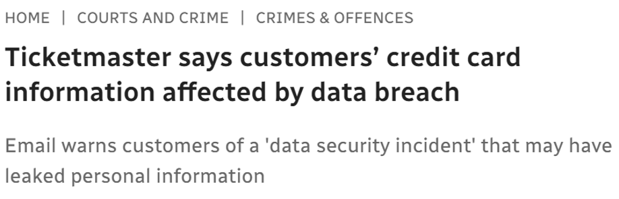
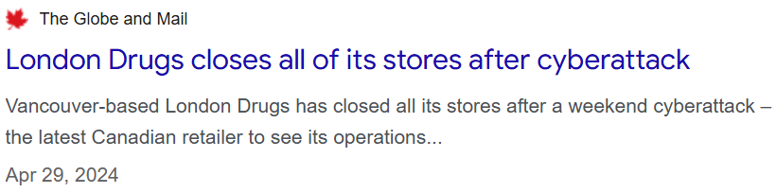
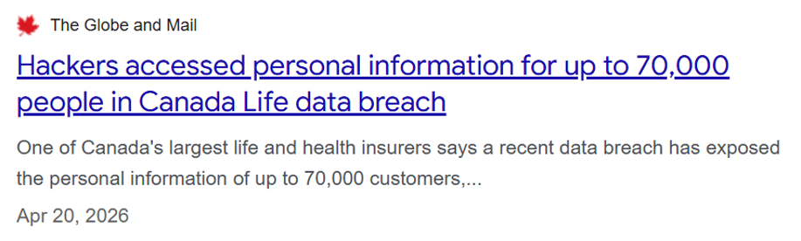
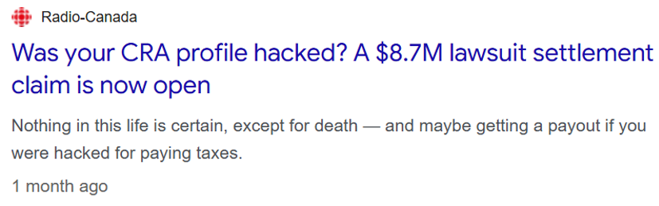
CYBERATTACKS THAT MAKE HEADLINES
The incidents everyone remembers
LONDON DRUGS
TICKETMASTER
Stores close after
a cyberattack
CANADA LIFE
Corporate information stolen
Closed all 79 stores for about a week
CRA
© McInnes Cooper, 2026

Slide 4
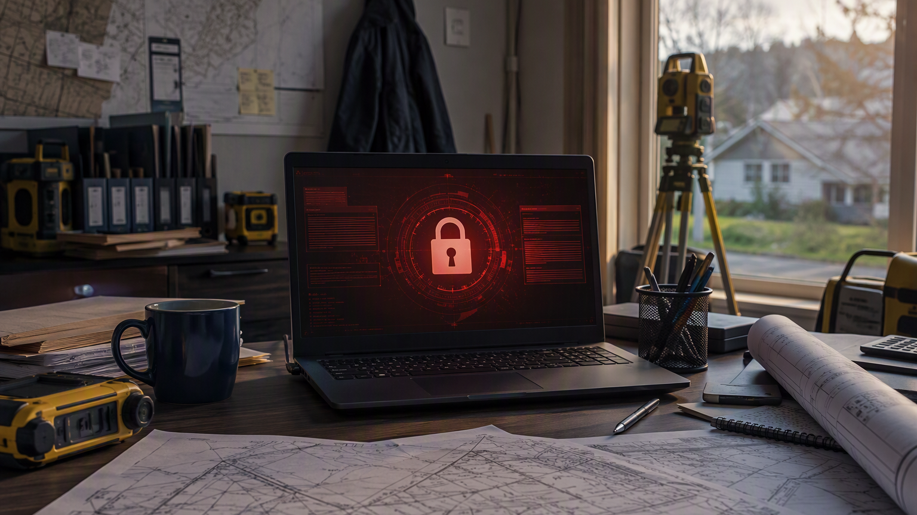
CYBER ATTACKS THAT DON’T MAKE HEADLINES
“Someone got into our email and files...
What do we do now?”

Slide 5

CYBERCRIME HAS CHANGED
Modern Realities of Cyber Threats
THEN
NOW
The old stereotype
An organized, automated industry
A lone, highly skilled hacker
Targeting a famous person, government or global company
Breaking through a firewall with a technical attack
Profit-driven, structured and coordinated
“Netcasting”: automated tools scan the internet 24/7 for unlocked doors
Opportunistic: whoever is easiest, not whoever is biggest
Cybercrime-as-a-Service business model
Modern Myth of Cyber Threats: “We're Too Small to Be a Target”
© McInnes Cooper, 2026

Slide 6
STATISTICS
Cyber Attacks on Canadian Businesses
1 in 6
$1.2B
50%
26%
Canadian businesses were impacted by a cyber security incident in 2023
spent by businesses recovering from cyber incidents in 2023 — double 2021
of impacted businesses were hit by scams and fraud, the most common incident type
of businesses had a cyber security policy in place
ONLY ABOUT 1 IN 8 AFFECTED BUSINESSES REPORTED THE INCIDENT TO POLICE
Source: Statistics Canada, Canadian Survey of Cyber Security and Cybercrime, 2023 (The Daily, October 21, 2024).
© McInnes Cooper, 2026

Slide 7

Are You at Risk?
Do you…
Store client or financial information?
Use a phone or laptop for business?
Keep survey plans or project files electronically?
Share devices or passwords?
Rely on email for documents or payments?
Use public Wi-Fi?
Work from home or in the field?
Put off software updates?
IF YOU ANSWERED “YES” TO ANY OF THESE, YOU'RE AT RISK.
© McInnes Cooper, 2026

Slide 8
THE PATH OF LEAST RESISTANCE
Why Target a Small Surveying Business?
Attackers look for who has the least protection, not the most money.
VALUABLE DATA
Client, financial, property and project information
LIMITED IT
Few or no dedicated security resources and may operate from a home office or in the field
DEPENDENCE
Email, cloud accounts and connected devices keep work moving
PRESSURE TO RECOVER
Downtime stops billing and client work — small firms are more likely to prioritize getting back to work
© McInnes Cooper, 2026

Slide 9
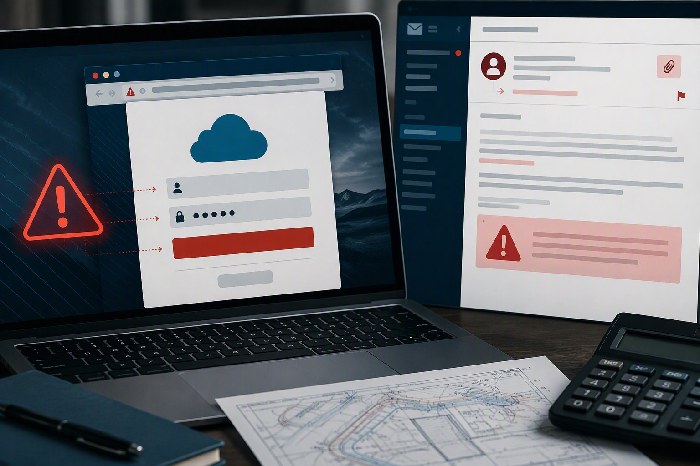

Phishing: What to Watch For
COMMON WARNING SIGNS
Unexpected urgency
A link to “verify” or sign in
An unusual attachment
A request for passwords or sensitive information
A sender address that's slightly wrong
If the request matters, verify it through a contact method you already trust.
© McInnes Cooper, 2026

Slide 10



Business Email Compromise (BEC)
TWO WAYS IT HAPPENS
SIGNS YOUR ACCOUNT MAY BE COMPROMISED
Account takeover
They log into your real mailbox — usually with a password stolen by phishing — then read, watch and send as you.
Sent emails you didn't write
Contacts replying to messages you never sent
Forwarding or inbox rules you didn't set up
Impersonation
No break-in needed: a look-alike address (“rn” for “m”) or a fake display name poses as you or someone you trust.
Sign-in or password alerts you didn't trigger
Emails or replies that seem to go missing
WHAT THEY DO WITH IT
Redirect payments
Steal client information
Phish your contacts
If you suspect it: change your password, turn on MFA, check your forwarding rules — and call your IT provider.
Phishing or system weaknesses can lead to BEC
© McInnes Cooper, 2026

Slide 11
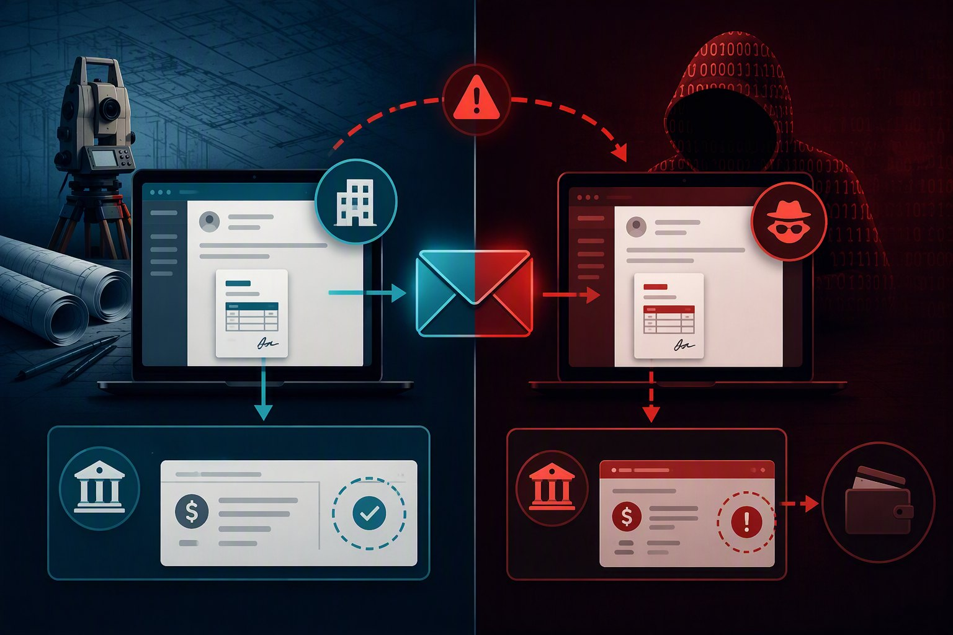
A LEGITIMATE ACCOUNT CAN SEND A FRAUDULENT REQUEST
Payment Fraud: Verify the Change
A TYPICAL SCENARIO
1
A mailbox is compromised or convincingly impersonated
2
The fraudster quietly watches an existing transaction
3
New banking or payment instructions are sent
4
The payment goes to the wrong account
CONFIRM PAYMENT CHANGES BY PHONE, USING A NUMBER YOU ALREADY HAVE ON FILE.
© McInnes Cooper, 2026

Slide 12





WHAT'S IN YOUR INBOX
Why Your Email Account Is Valuable
1 · WHAT THEY SEE
YOUR INFORMATION
2 · WHAT THEY USE
YOUR CONTACTS
Once inside, an attacker can quietly read everything in your mailbox.
Then they use it
Your contacts — and their trust in you — become the real target:
1
Who you deal with and exactly how you write
For a surveyor, that includes:
2
Phishing sent from your own email account
Client emails
Project files & invoices
Payment & banking details
3
Clients, lawyers and developers targeted by someone pretending to be you
You don't need to be big to have something a criminal wants.
© McInnes Cooper, 2026

Slide 13
IT'S 7:30 MONDAY MORNING...
You notice emails went out to clients over the weekend that you didn’t send
They asked clients to send payment to a new account.
A lawyer you work with on a client file calls: “Did you just send me a sign-in link?”
Your email has been compromised. Now what?

Slide 14




SCENARIO:
Compromised Email Account
1
2
3
4
A fake sign-in page
Quiet access for weeks
Sent from your account
The damage spreads
A client wires money to the “new” account. A contact enters their password, and another professional calls to ask why you e-mailed them asking for payment.
A staff member enters their password on a fake Microsoft 365 login. There's no MFA.
The attacker reads client emails, plans, invoices and contact lists — and sets up hidden forwarding.
Phishing emails go out from your real address to lawyers, developers and clients.
WHY IT'S A PROBLEM
Client information exposed
Names, addresses, plans, IDs and banking details sit in emails and attachments
Your contacts become targets
Messages from your real address are trusted by your clients, employees, and vendors
Money stolen or trust damaged
Redirected money and professional or relationships impacted by fraudulent attempt
Legal obligations kick in
Unauthorized access to personal information is a breach under PIPEDA

Slide 15






What a Cyberattack Actually Costs
Downtime
Lost revenue
Recovery costs
Impact to files, email, scheduling or historical records
If you can't work, you can't generate revenue
IT forensics, restoration, new equipment, legal advice, notification
Client relationships
Professional reputation
Legal exposure
“How did you let this happen?”
Damage to reputation
Regulators, clients and the people whose information was taken
THESE COSTS ADD UP AND CAN BE SIGNIFICANT
© McInnes Cooper, 2026

Slide 16
THE LEGAL SIDE OF CYBER RISK
WHAT DOES THE LAW EXPECT OF YOU?
Reasonable safeguards and proactive responses

Slide 17





WHERE YOUR LEGAL OBLIGATIONS COME FROM
PIPEDA imposes obligations on private businesses collecting personal information in the course of business in Nova Scotia
PRIVACY LEGISLATION
Work for government or municipalities can bring provincial rules (e.g., PIIDPA)
PUBLIC-SECTOR WORK
PROFESSIONAL OBLIGATIONS
The ANSLS Code of Ethics requires reasonable care and competence
What you've promised your clients, and what your vendors have promised you
CONTRACTS
COMMON LAW
Negligence, breach of contract and breach of confidence claims
ALL REQUIRE: TAKE REASONABLE STEPS TO PROTECT PERSONAL INFORMATION
© McInnes Cooper, 2026

Slide 18






PRIVACY LEGISLATION
Privacy Obligations Under PIPEDA
Nova Scotia has no general private-sector privacy law, so the federal Personal Information Protection and Electronic Documents Act (PIPEDA) applies to personal information you collect in the course of your business.
THREE KEY OBLIGATIONS FOR CYBERSECURITY
1
Accountability
Name someone responsible for privacy, even in a solo practice.
WHAT YOUR PRACTICE LIKELY HOLDS
Client names and contact details
Property owner and neighbour details
2
Safeguards
Protect information with safeguards appropriate to how sensitive it is.
Banking and payment information
Identification documents
3
Retention
Securely destroy or anonymize information you no longer need.
Emails and correspondence
Plans tied to identifiable owners
IF IT CAN IDENTIFY A PERSON, IT'S PERSONAL INFORMATION.
© McInnes Cooper, 2026

Slide 19




PIPEDA: Protect + Respond
1 · BEFORE A BREACH
PROTECT
2 · AFTER A BREACH
RESPOND
Put reasonable safeguards in place to protect personal information.
If safeguards fail
If those safeguards are breached, take the required steps:
1
Assess the risk of harm to individuals
Appropriate to the sensitivity of the information you hold:
2
Report and notify the Commissioner and individuals, if there's a real risk of significant harm
Physical
Organizational
Technical
3
Keep a record of every breach — even below the reporting threshold
PIPEDA, Schedule 1, Principle 4.7 (Safeguards)
PIPEDA, ss. 10.1–10.3
PIPEDA requires businesses to protect personal information and respond appropriately when safeguards fail
© McInnes Cooper, 2026

Slide 20
WHAT DOES "REASONABLE" MEAN?
“Reasonable Safeguards" Are Risk-based
ASK YOURSELF
What information do we have?
How sensitive is it?
Who has access to it?
1
2
3
How could someone get in?
What if it were stolen or locked?
What safeguards fit that risk?
4
5
6
THEN MATCH YOUR SAFEGUARDS TO THE RISK
Physical
Organizational
Technological
Locked offices and cabinets; devices kept secure in vehicles and at home
Written policies, training, need-to-know access, a named privacy lead
MFA, strong passwords, encryption, updates and tested backups
WRITE IT DOWN. DOCUMENTED SAFEGUARDS ARE YOUR BEST EVIDENCE.
© McInnes Cooper, 2026

Slide 21



MANDATORY BREACH REPORTING UNDER PIPEDA
A Breach Happened – Do You Have To Report It?
Report to the Privacy Commissioner
As soon as feasible, in the prescribed form
Breach of security safeguards
Is there a real risk of significant harm?
YES
Notify affected individuals
As soon as feasible — directly by email (with consent), letter, phone or in person
Notify organizations that can reduce harm
For example, banks, credit bureaus or police
ASK TWO QUESTIONS
How sensitive is the information?
How likely is it to be misused?
ALWAYS — even with no real risk: keep a record of every breach of security safeguards, no matter how minor, for 24 months — and provide it to the Commissioner on request.
Knowingly failing to report, notify or keep records is an offence: fines of up to $100,000.
© McInnes Cooper, 2026

Slide 22


NEGLIGENCE AND CIVIL LIABILITY
CYBER INSURANCE
Civil Lawsuits and Insurance
It helps — if you meet its conditions.
WHAT CLIENTS AND OTHERS MAY CLAIM
Negligence
Failing to use reasonable safeguards
Many policies require MFA, backups and training
Most require prompt notice — call before you hire your own vendors
Many include breach lawyers and forensic firms
Check what's covered: forensics, legal, notification, fraud losses
Breach of contract
Failing to meet security or confidentiality promises
Breach of confidence
Misuse of information shared in confidence
YOUR BEST DEFENCE: REASONABLE SAFEGUARDS — DOCUMENTED.
© McInnes Cooper, 2026

Slide 23


MANAGING OBLIGATIONS
Your People, Your Vendors, Your Contracts
Employees
Vendors
Client contracts
Give access on a need-to-know basis
Same-day offboarding: shut off accounts, collect devices, change shared passwords
Confidentiality terms and short, regular training
You stay responsible for client information your cloud provider, IT person or bookkeeper holds
Ask: how is it secured, where is it stored, how fast will they tell you about a breach?
Watch for breach-notice deadlines
Don't promise security you can't deliver
Check liability limits and insurance requirements
YOU CAN OUTSOURCE THE WORK — NOT THE RESPONSIBILITY.
© McInnes Cooper, 2026

Slide 24
PROTECTING YOUR BUSINESS
What Can You Do About It?
Protect now. Be ready. Respond quickly.

Slide 25






WHAT YOU CAN DO · 1. BEFORE
Six Steps to Protect Your Business Now
1
Turn on multi-factor authentication
Email first, then banking and cloud storage. A stolen password alone is no longer enough.
2
Train your team
Short, regular reminders on spotting scam emails — for everyone, including you.
3
Verify payment changes or urgent requests by phone
Use an alternative contact you already have — never one from the email asking for the change.
4
Keep a backup you can't lose
Store a copy separately from your computer, and check that you can actually restore it.
5
Keep devices updated and locked
Turn on automatic updates. Use passcodes and encryption on laptops, phones and field tablets.
6
Clean out and lock down
Delete old emails and files you no longer need. Remove access for anyone who has left.
NONE OF THESE NEEDS AN IT DEPARTMENT. MOST CAN BE DONE THIS WEEK.
© McInnes Cooper, 2026

Slide 26


WHAT YOU CAN DO · 2. BE READY
Make a Plan Before You Need It
KNOW WHO YOU'LL CALL
Your IT provider
To stop the problem and find out what happened
WRITE IT DOWN
Your insurer
Call early — many policies require prompt notice
Names and phone numbers for each call
Your lawyer
To assess your legal obligations and help with notices
Your insurance policy number and what it requires
Where your backups are and how to restore them
Your bank
To stop or recall a payment as quickly as possible
Who in your office makes decisions
Police and the Canadian Anti-Fraud Centre
To report the fraud
IF YOUR EMAIL IS DOWN, A PLAN SAVED IN YOUR EMAIL WON'T HELP.
© McInnes Cooper, 2026

Slide 27
SCENARIO:
Compromised Email Account – What To Do
STOP IT
Right away
FIND OUT AND TELL
In the first few days
LEARN FROM IT
Afterwards
1
2
3
Change the password and sign out of all devices
Turn on multi-factor authentication
Remove any forwarding rules you didn't set up
Call your bank if money has moved
Have IT check what was accessed, and for how long
Warn your contacts not to act on recent requests
Call your lawyer and insurer — report and notify if required
Report fraud to police and the Anti-Fraud Centre
Keep a written record of the breach — it's required
Fix the gap that let them in
Remind your staff what to watch for
DON'T WAIT FOR PERFECT INFORMATION. START RIGHT AWAY.

Slide 28


RESOURCES
Where to Learn More
Get Cyber Safe Guide for Small Businesses
getcybersafe.gc.ca
Baseline Cyber Security Controls for Small and Medium Organizations
Canadian Centre for Cyber Security · cyber.gc.ca
What You Need to Know About Mandatory Reporting of Breaches
Office of the Privacy Commissioner of Canada · priv.gc.ca
PIPEDA Breach Report Form
Office of the Privacy Commissioner of Canada · priv.gc.ca
Report Fraud and Cybercrime
Canadian Anti-Fraud Centre · antifraudcentre-centreantifraude.ca
PIIDPA — Frequently Asked Questions
Government of Nova Scotia · novascotia.ca
© McInnes Cooper, 2026

Slide 29

QUESTIONS?
Sarah Anderson Dykema
McInnes Cooper
This presentation provides general information only and is not legal advice. © McInnes Cooper, 2026.

